Slide 1

Unichat SYSTEM
Group members:
Ereina
Ronald
Karen
Chau
Notes:
NOTE:
To change the image on this slide, select the picture and delete it. Then click the Pictures icon in the placeholder to insert your own image.

Slide 2
Content
UniChat Introduction
UniChat Functionalities
Register an Account
Log in
Update Profile
Become Friends
Send Messages
Create Group
Share Posts
Q&A

Slide 3
1. UNICHAT Introduction

Slide 4

1. UniChat Introduction
Universal platform for communication among students of USyd
Taking inspiration from other global platforms such as WeChat and Facebook

Slide 5
2. UNICHAT FUNCTIONALITIES

Slide 6
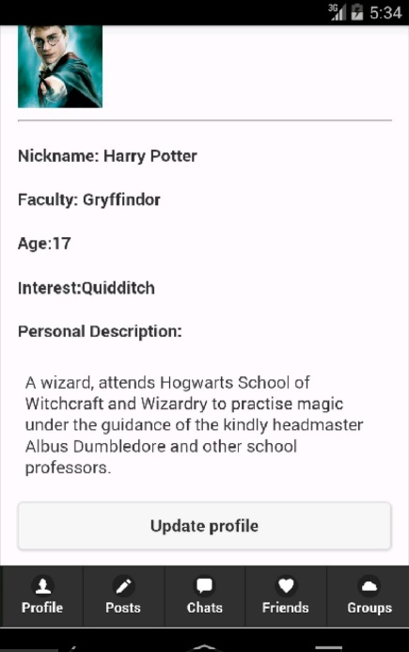
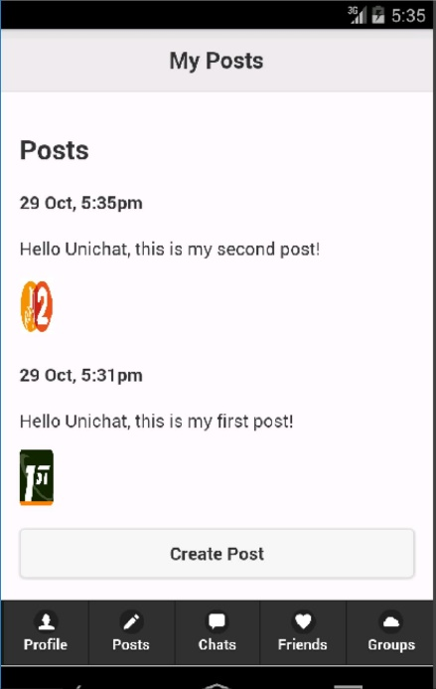
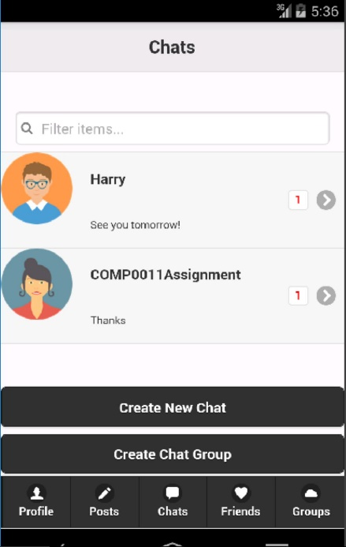
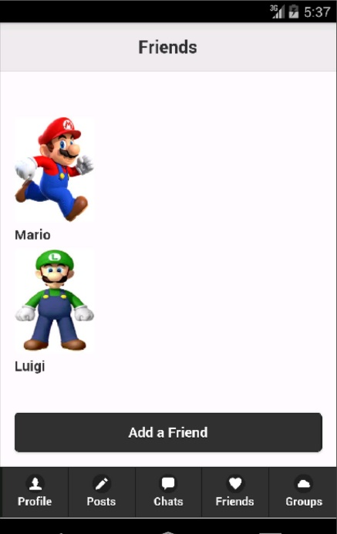
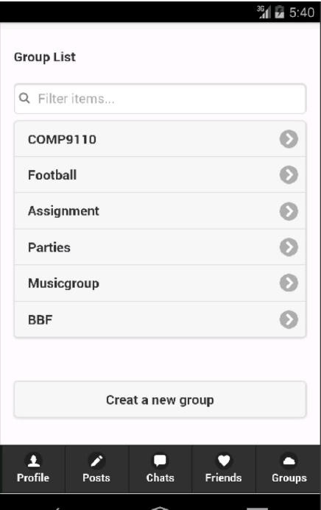
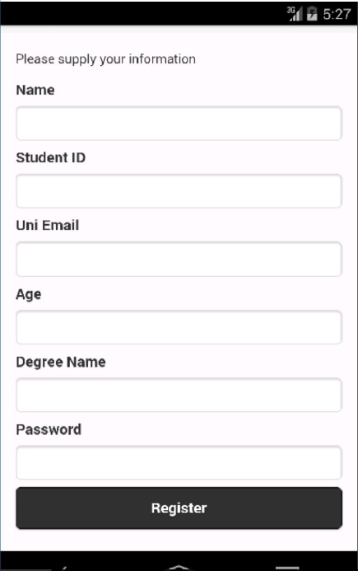
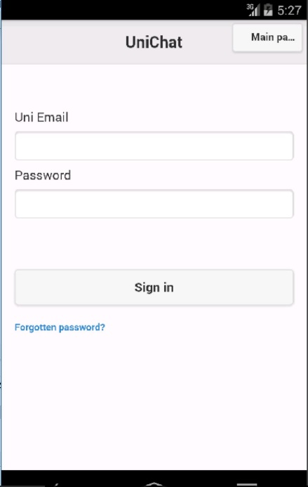
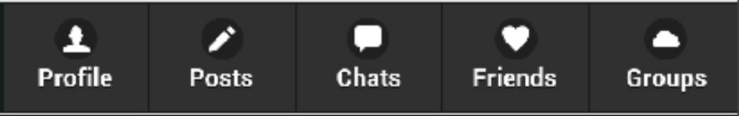

Slide 7
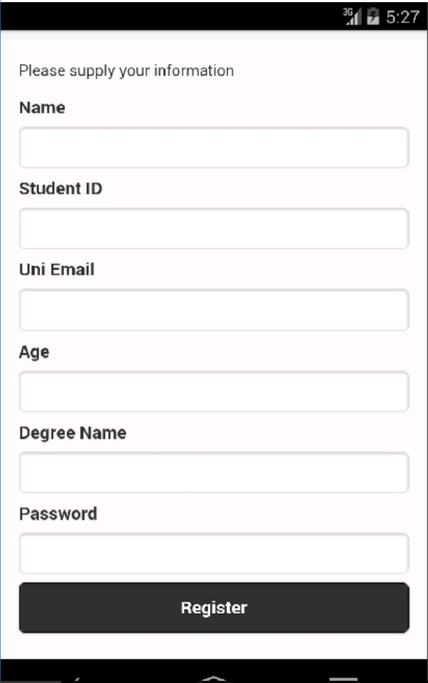
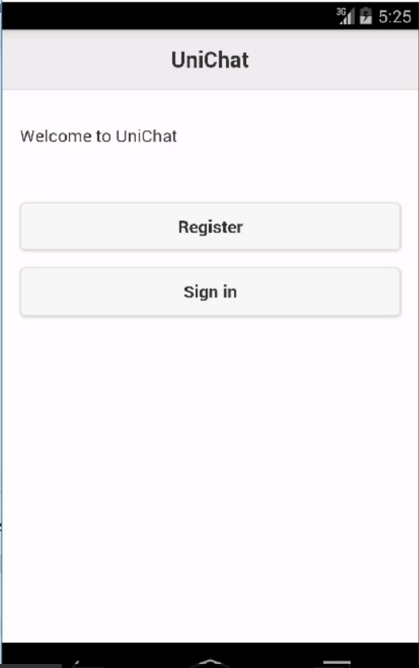

Register an Account
Only university students can register
First time users need to supply personal information to register
Email with a link to verify their identity

Slide 8
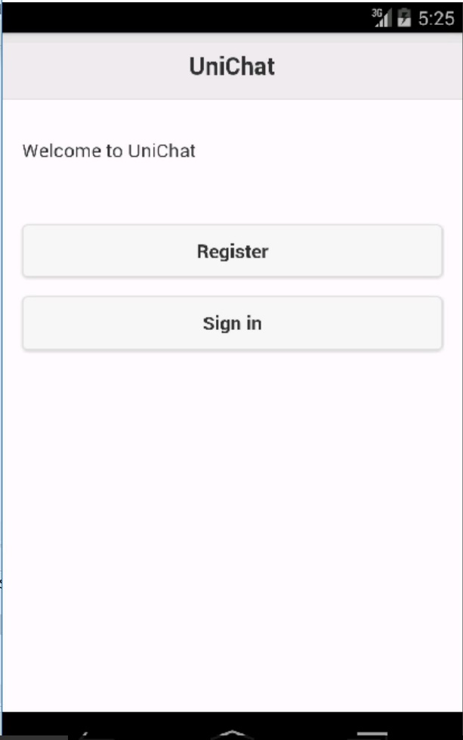
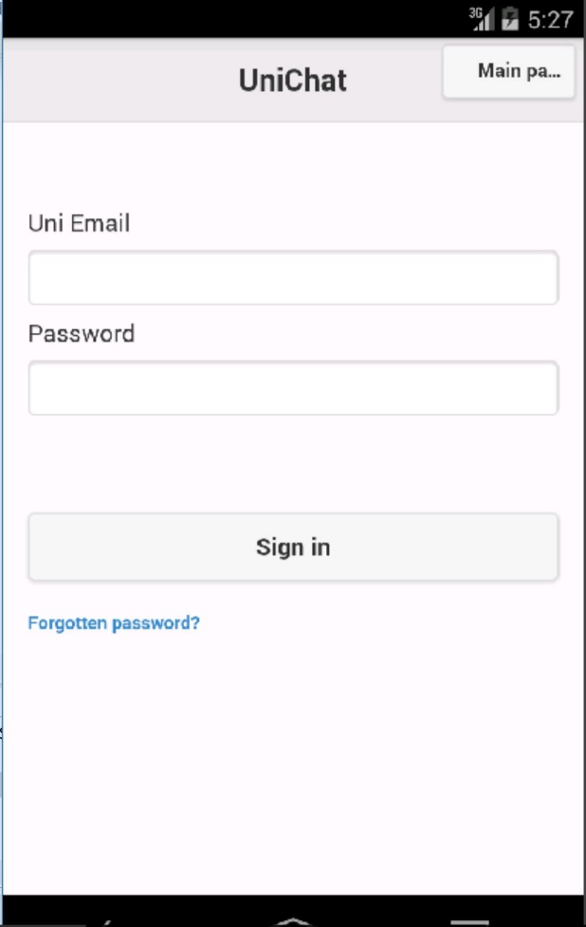
Log in Account
Login using Uni email and password
harry.potter@hogwarts.edu.earth
************

Slide 9
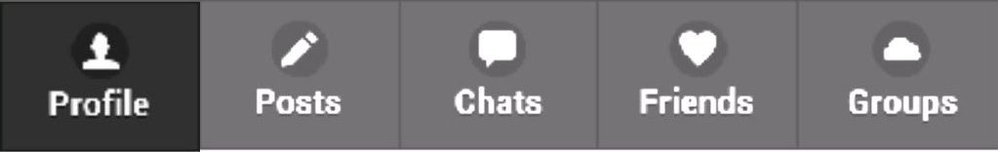
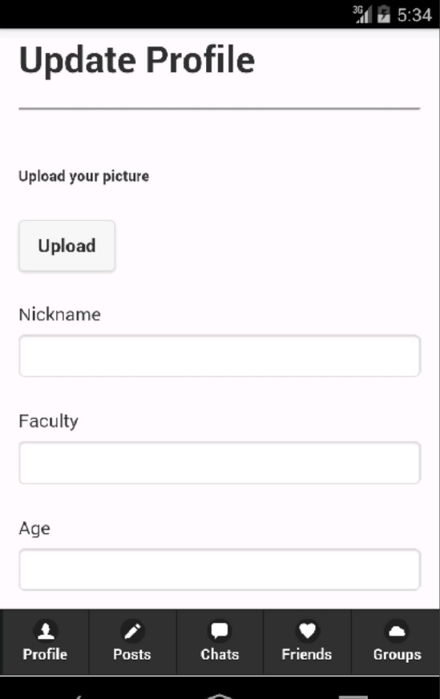

Update Profile
Users can setup their own profile
Choose nickname, personal description and avatar
The profile is public to all other students
Harry Potter
The Chosen One
Gryffindor
17

Slide 10
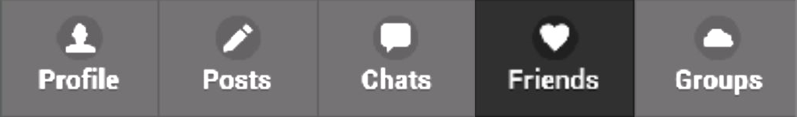

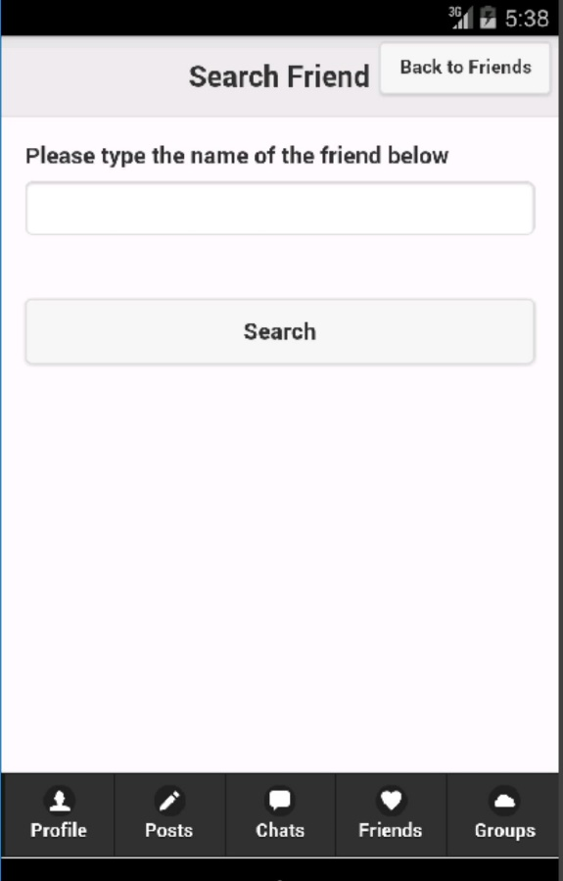
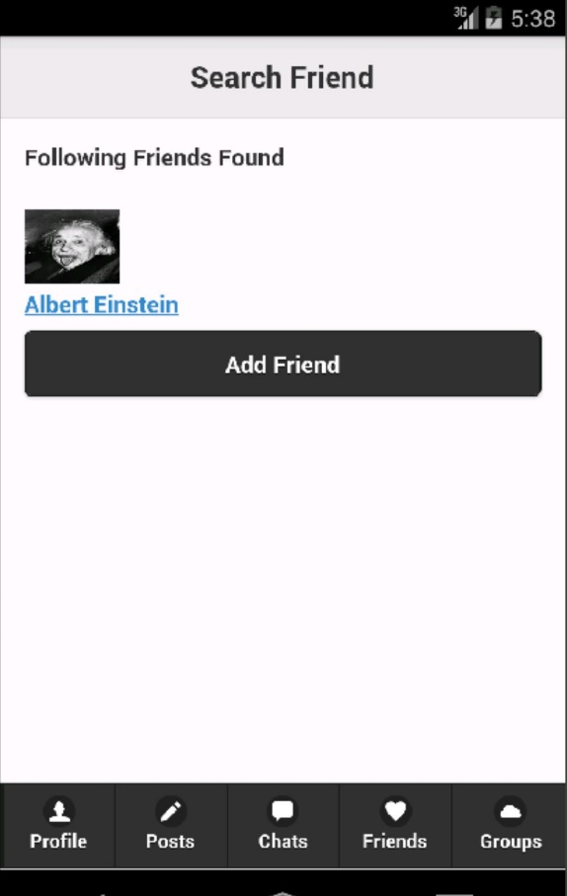
Become Friends
Users can add friends by searching for the friend by their name
Then select the profile of the friend and send a friend request
Once the potential friend accepts the request the user adds the friend to their friend list.
Albert Einstein

Slide 11
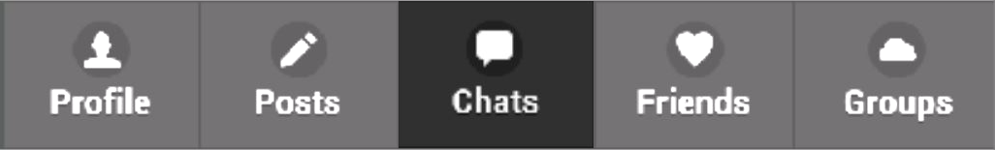
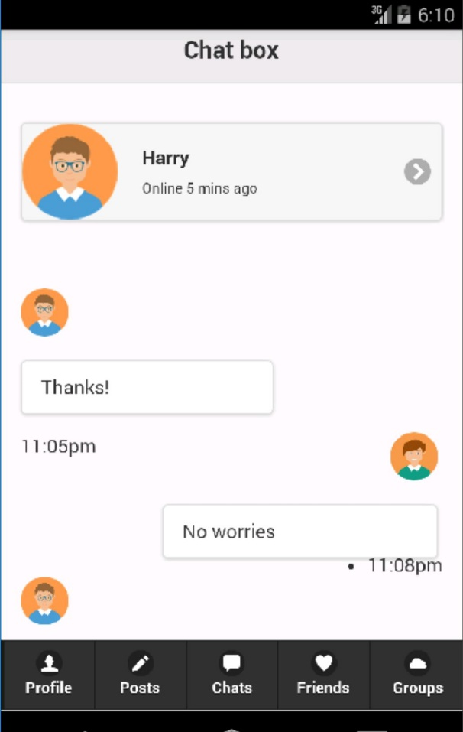

Send Message
Users can send their friends instantaneous messages.
Users will also be notified whether their friend has received the message and if they have read the message

Slide 12
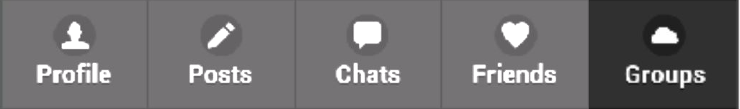
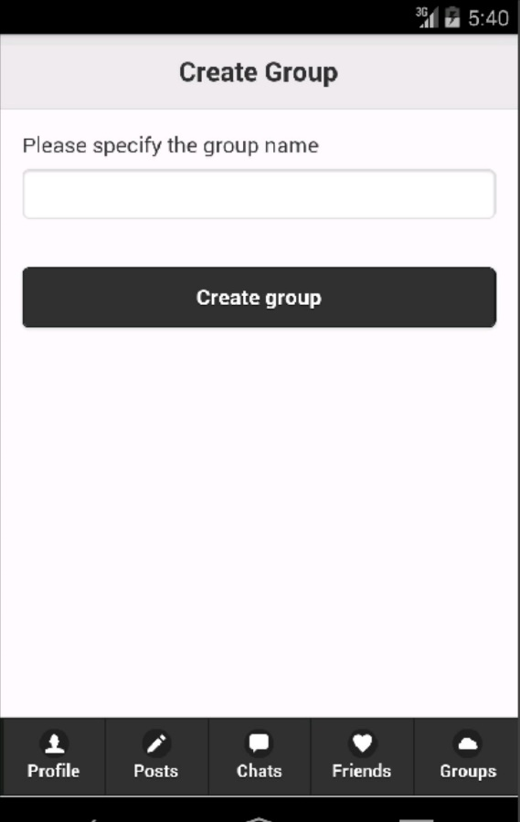
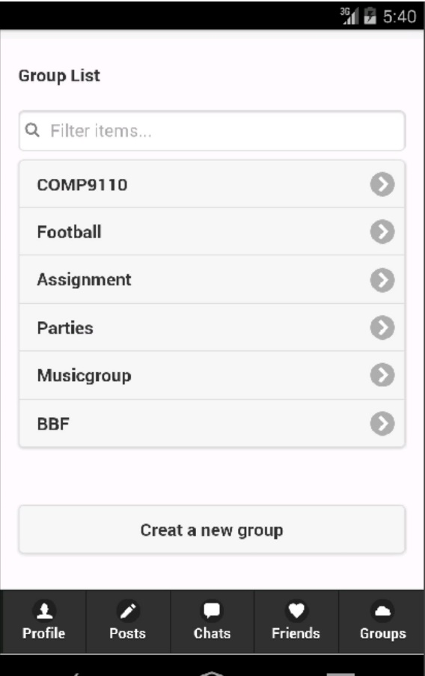
Create Group
Users can create chatgroups with personalized names
All the groups members of the chat group can invite new members to join
All group members can change the group name

Slide 13
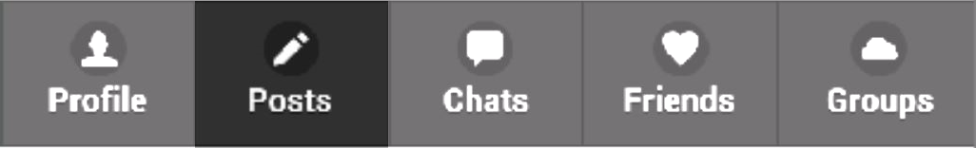
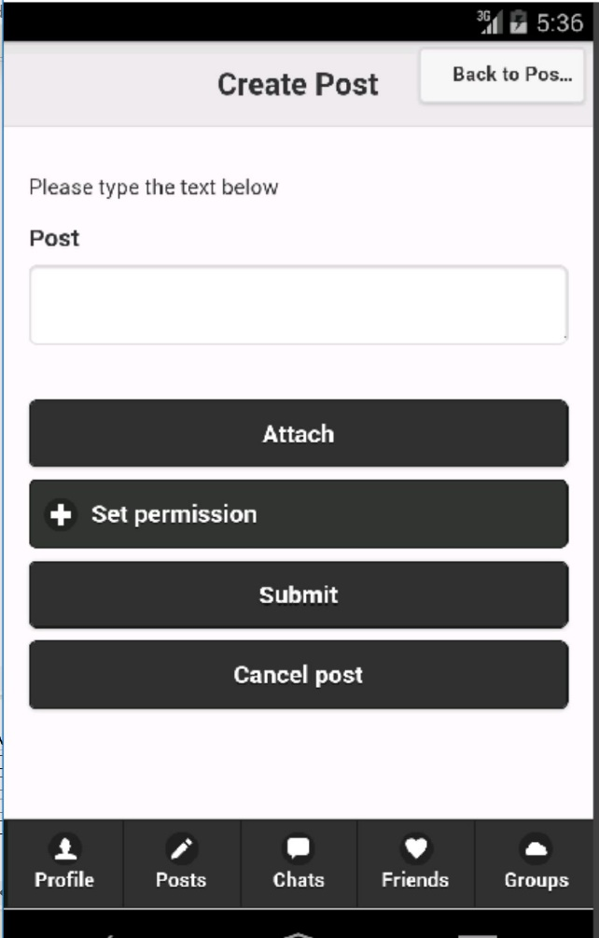
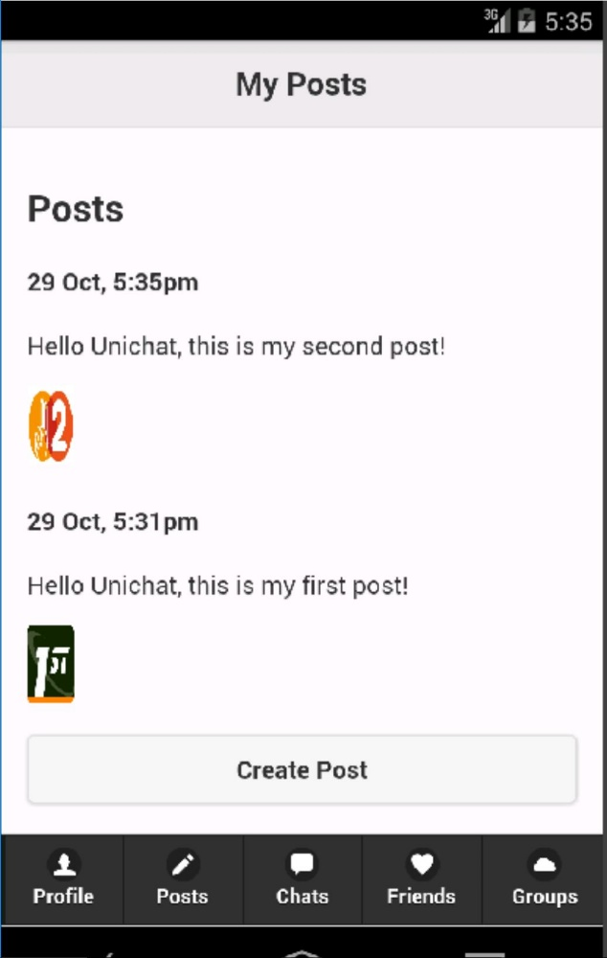
Share Posts
Users can create posts with text, image or video
User can set the share permission for the post – Public, Private or Limited

Slide 14
3. Q & A

Slide 15

Thank you for watching

